Slide 1






Overview
Vehicle Type
Revenue
Cancellation
Ratings

Slide 2
Overview
Vehicle Type
Revenue
Cancellation
Ratings

Slide 3
Overview
Vehicle Type
Revenue
Cancellation
Ratings

Slide 4
Overview
Vehicle Type
Revenue
Cancellation
Ratings

Slide 5
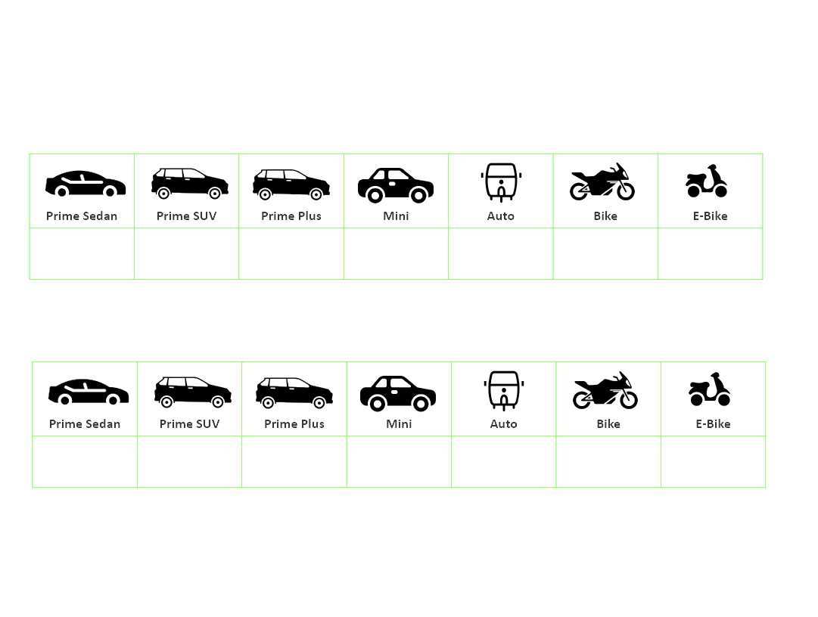
Overview
Vehicle Type
Revenue
Cancellation
Ratings

